Slide 1
Dissemination of Warnings and Forecasts
African Regional Training on Severe Weather Forecasting and Warning Service – Workshop on Public Weather Services
Pretoria, 16th -20th November 2015

Slide 2
Outline
  Discuss how we disseminate our forecasts and warnings.
  Discuss which methods are most effective in which circumstances?
  Discuss the advantages and disadvantages of using social media
  Discuss what we need to consider when developing a website

Slide 3
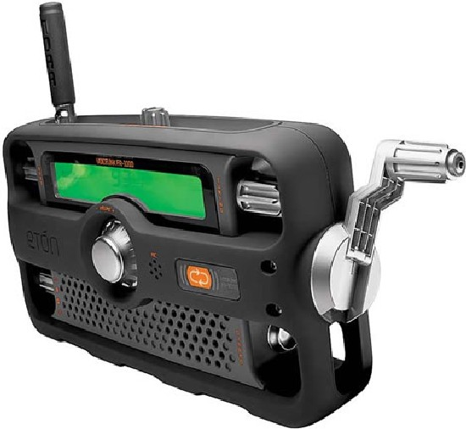
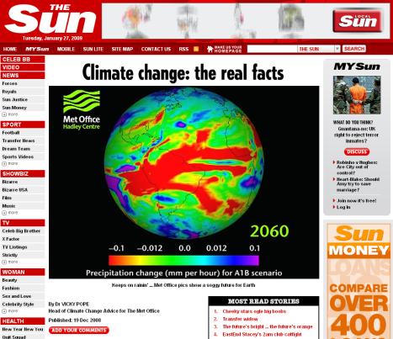

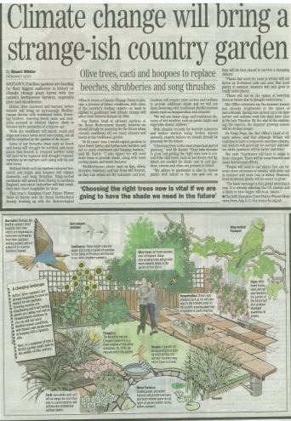
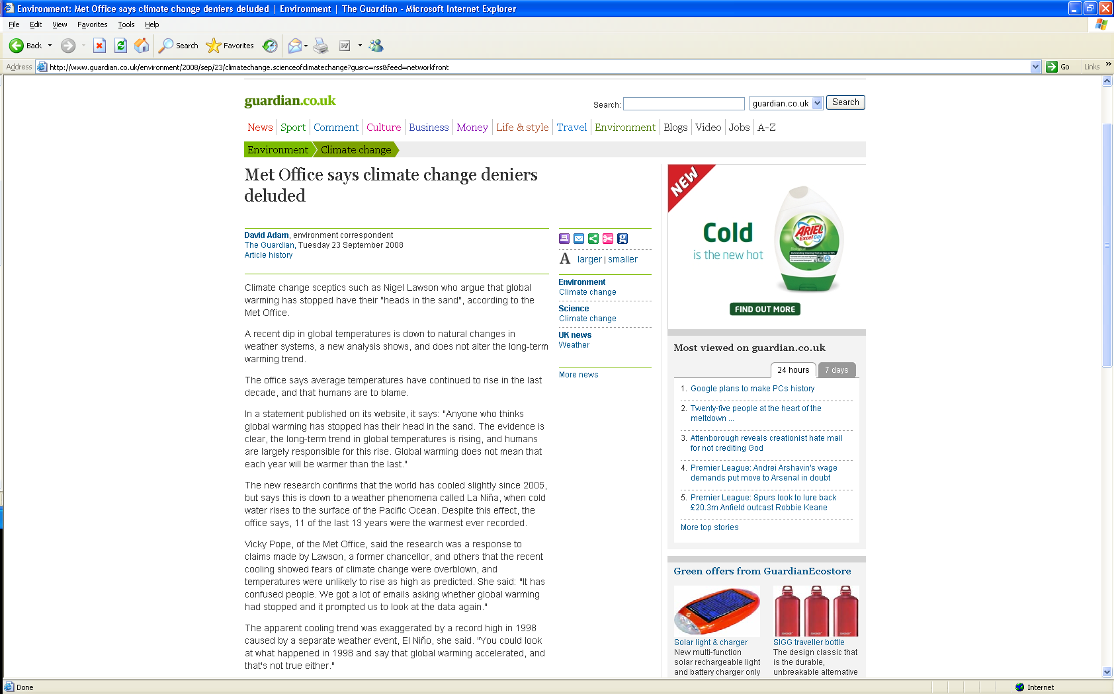
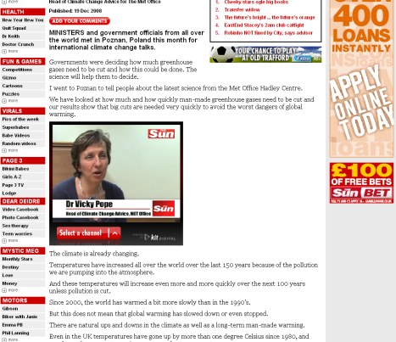

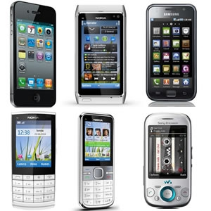
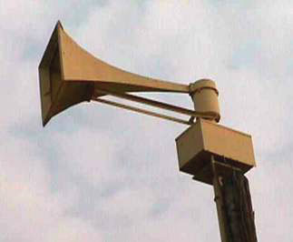



Methods of Communication

Slide 4
Methods of Communication
  Which method(s) are best for getting messages to:
    Disaster Managers?
    The general public?
    Rural communities and/or those without access to modern technology?
  Whatever method is used, our messages must be:
    Clear, in plain language
    Jargon-free
    Timely

Slide 5
Communicating our forecasts and warnings - UK
Met Office website
Text and email alerts (especially to disaster managers)
TV and radio (national & local)
Mobile Phone / App
Social Media
  You Tube
  Twitter
  Facebook
Blog
Third-party on-line methods (websites & apps)
Notes:
There are many ways that we disseminate our warnings and forecasts in the UK

Slide 6
Social Media

Slide 7
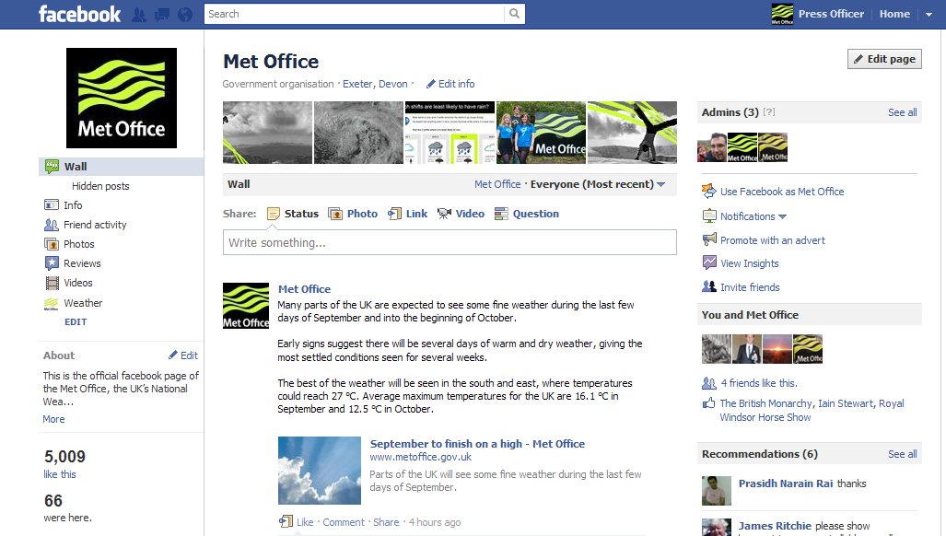
Facebook www.facebook.com/metoffice
What is Facebook?
Facebook is a online social network where members can become a fan of a brand or organisation and receive its updates.
What we’re doing on Facebook
Fans can get updates on weather conditions and information on weather phenomena, ask questions, view severe weather warnings and share pictures.
Facebook statistics
Met Office has over 48,000 ‘likes’

Slide 8
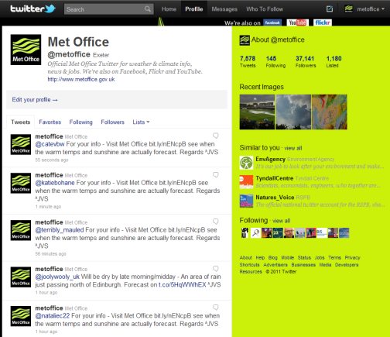
Twitter www.twitter.com/metoffice
What is Twitter?
Twitter is a micro-blogging platform where users share updates with their followers in under 140 characters
What the Met Office do on Twitter
24/7 customer service response. Severe weather alerts, news stories, press releases, events.
Twitter statistics - Met Office has over 200,000 followers
Notes:
(On YouTube we have 8,500 subscribers and 2.1 million views)
(On Google+ we have 111,000 views)

Slide 9
Social Media
What are the advantages of social media?
What problems might there be with social media?

Slide 10
Social Media
Advantages of Social Media?
Communication of message is fast
The message can reach a huge number of people, especially if your messages are re-tweeted/liked by partners and others.
Some of the problems with Social Media?
Can be resource intensive. Those who put enquiries into your organisation via Twitter expect a quick response – whatever the time of day.
Twitter -- limitation to size of message (140 characters)
Remember to check that you are using the right account!
Develop a clear social media strategy to guide staff
https://www.wmo.int/pages/.../1086_PWS-24_NMHSs_report_en.pdf
Notes:
(On YouTube we have 8,500 subscribers and 2.1 million views)
(On Google+ we have 111,000 views)

Slide 11
Social Media
Using Social Media – some guidelines
  Establish clear protocols. Information should be consistent with your organisation’s policies.
  Identify yourself as part of the organisation. Build a relationship with the audience.
  Remember the audience will consist of users with a wide variety of interests and attitudes. Be careful when framing messages so that the discussion is inclusive.
  Focus on positive messages and avoid comments that have the potential to offend or inflame.
  Make sure to address questions and concerns that are raised by participants.
  Provide useful information.
Notes:
(On YouTube we have 8,500 subscribers and 2.1 million views)
(On Google+ we have 111,000 views)

Slide 12
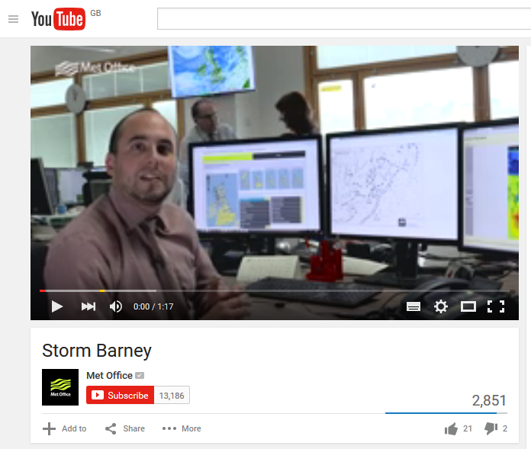
What is YouTube?
A website to which anybody can upload video clips
What are we doing on YouTube?
We post videos explaining the latest weather, other weather phenomena in the news e.g. El Nino, etc.
An education tool.

Slide 13
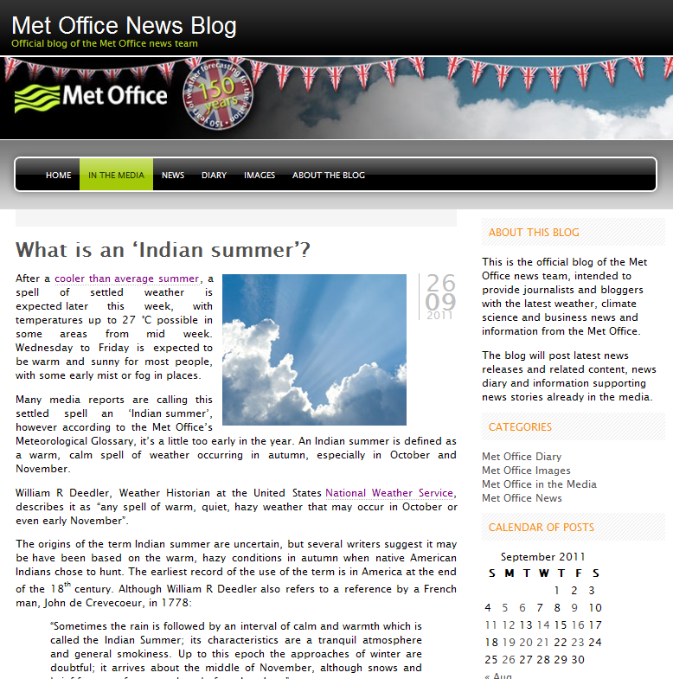
Met Office news “blog” (Web log) www.metofficenews.wordpress.com
What is a blog?
Blogs contain frequently updated ‘posts’, and are often commentary or personal opinion. The most recent post is always at the top of the page.
What we’re doing on the blog
Response to news reports, explanatory ‘what is…’ posts, climate news, etc.

Slide 14
Websites

Slide 15
Developing a website?
What do we need to consider?
Always keep in mind what information visitors to your site would want/expect to see?
What makes a good website?
  Key information is easy to find
  Website is easy to navigate
  Makes good use of graphics
What are some poor features of websites?
  Key information is difficult to find!
  Website is NOT easy to navigate!
  All text – less interesting
  Advertising?

Slide 16
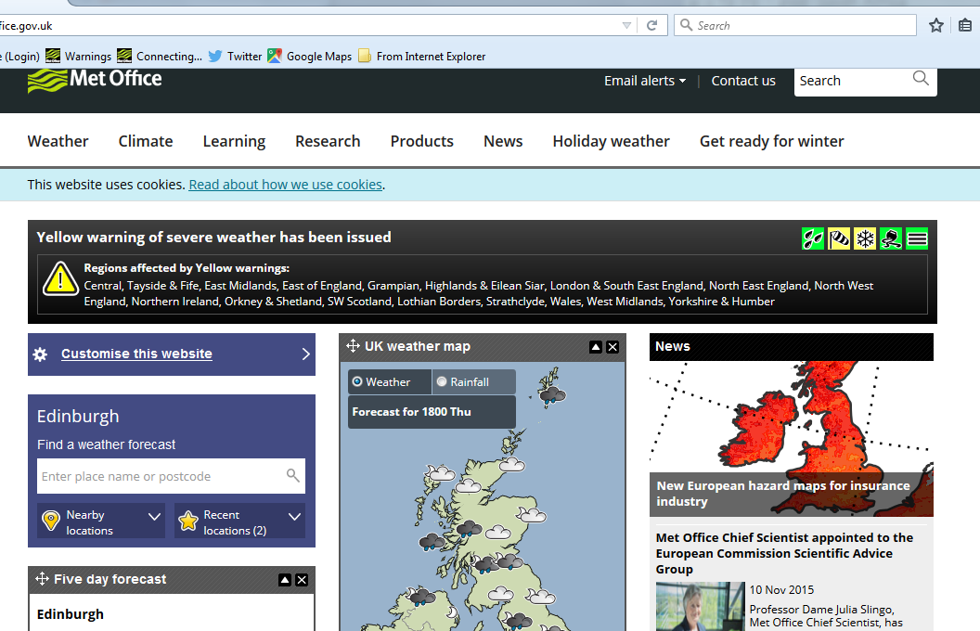
Met Office website
Homepage (with warnings banner)

Slide 17
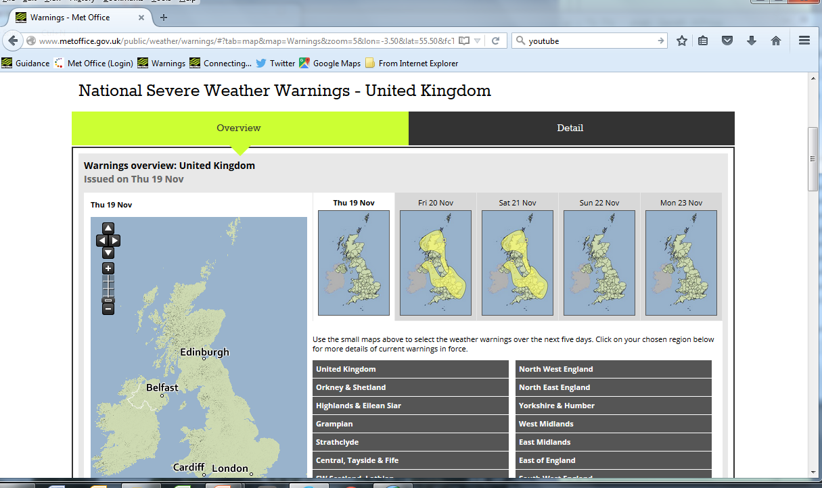
Met Office website
Homepage (with warnings banner)

Slide 18
Questions?

